Slide 1
KV6002 Week 4 – Teamworking (Evidence, Good Practice & Keeping Records)
Dr Rebecca Nicholson

Slide 2

KV6002 Team Project and Professionalism – Week 1
Today I will:
1. Go through teamwork best practice
2. Cover ways of keeping records
3. Give some tips for how to handle teamwork issues.

Slide 3
Why are we covering this?
As I’ve said before – we do acknowledge the issues inherent with teamwork. It’s always challenging – no matter how lovely your team mates are.
You have to be more responsive and often work to earlier deadlines.
Leaving it last minute is less of an option as you need feedback from team members / they might be relying on your work to finish theirs.

Slide 4
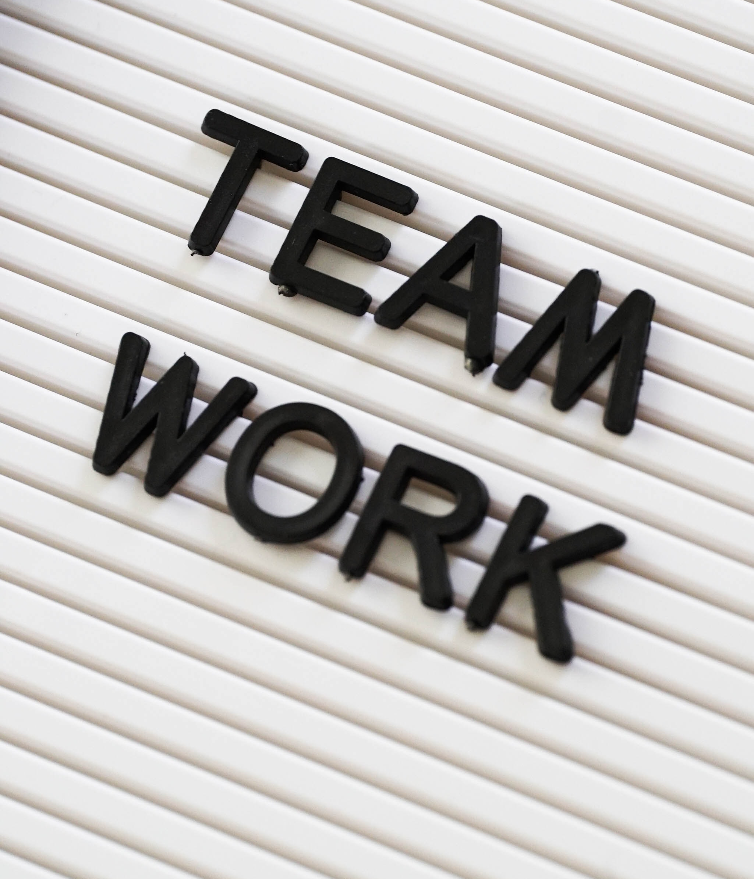
Collaborative Learning
Numerous Academic Benefits (Patiz 1999):
Improves Verbal Communication Skills
(Particularly ways of communicating tacit knowledge).
Supports ‘active’ learning.
Encourages Critical thinking
Laal, M., & Ghodsi, S. M. (2012). Benefits of collaborative learning. Procedia-social and behavioral sciences, 31, 486-490.

Slide 5
Effective Teamwork
Requires these 11 attributes (Chowdhury & Murzi 2019):
Shared Goal & Value,
Commitment to Team Success,
Motivation,
Interpersonal skills,
Open/Effective Communication,
Constructive Feedback,
Ideal Team Composition,
Leadership,
Accountability,
Interdependence
Adherence to Team Process & Performance
(Chowdhury & Murzi 2019)

Slide 6
Shared Goal & Value
The shared goals and values should promote common rules, group cohesion and flexibility.
For you this may mean:
Clear subsystems
Clear tasks
Clear team values (what you will do / what can you expect of others).

Slide 7
Commitment to Team Success
Commitment to succeed in the group
For you this may mean:
Setting out what success means for you as a group.
Viable subsystem? Marketable system? Finishing on time?
Clearly assigning tasks with success criteria.

Slide 8
Motivation
Motivated and satisfied with their team task
For you this may mean:
Ensuring you discuss and agree the subsystem splits
Altering / adapting briefs to ensure you are using your skills

Slide 9
Interpersonal Skills
High level of mutual trust among team members and productive interactions
For you this may mean:
Not micromanaging team members
Being honest about timeframes / deadlines
Try and see interactions as positive in the first instance.

Slide 10
Open / Effective Communication
Open dialogue, timely communication, and effective presentation of work to colleagues
For you this may mean:
Being clear about expectations, timelines, deadlines.
Responding to messages within agreed timeframes.

Slide 11
Interpersonal Skills
High level of mutual trust among team members and productive interactions
For you this may mean:
Not micromanaging team members
Being honest about timeframes / deadlines
Try and see interactions as positive in the first instance.

Slide 12
Constructive Feedback
Constructive criticism where team members provide and accept feedback from each other
For you this may mean:
Keep it specific and task-based
Focus on one aspect at a time
Try and give suggestions for improvement

Slide 13
Constructive Feedback
Team function including diversity, member roles, ideas, subject knowledge,
For you this may mean:
Undertaking a skills audit in your team
Being honest about your skills / weaknesses
Allowing everyone to work on a subsystem they are comfortable with

Slide 14
Leadership
Includes taking leadership role through consensus of the team, acting as a facilitator, monitoring tasks, dealing with conflict and accomplishing tasks.
For you this may mean:
Taking it in turns to be ‘leading’ the team
Ensuring you are all taking a ‘leading role’ at some point
Taking responsibility for your own subsystem / tasks

Slide 15
Interdependence
Helping each other and promote individual contribution within the group
For you this may mean:
Offering constructive feedback
Helping debug others subsystems
Asking for help!

Slide 16
Adherence to Team Process & Performance
Developing strategies/decision/solutions for effective work processes
For you this may mean:
Coming up with guidelines for how your team will work together
Pre-empting possible problems
Following agreed guidelines

Slide 17

Where does it go wrong?
In my experience?
Communication Issues

Slide 18
Communication is key
1. Make clear what you need from team mates.
2. Set clear deadlines.
It can be hard as sometimes it might seem like you’re being pushy
3. Give realistic timescales
- Don’t be tempted to underestimate how long something will take (time x 2 + contingency)

Slide 19
Communication is key
Things I suggest you agree as a team:
How you will communicate
The expected turnaround time for a response
Times you will be unavailable

Slide 20

Computer Supported Collaborative Learning
Whole field dedicated to exploring the role of digital technology in facilitating collaborative learning.

Slide 21
Platform-based communication
I STRONGLY suggest you select a platform of your choice to use for your team.
Suggested options:
Teams
Discord
Slack
Basecamp

Slide 22

Meetings
Things to consider:
Clear timeframes
Attendance
Agenda
Minutes

Slide 23
Peer Assessment Assignment 2
When you submit Assignment 2 (the demo) you will also submit a peer assessment document.
This is already linked in the assessment brief on blackboard.
It will scale your marks according to the peer marks you receive.
If the team is all marked equally everyone gets the same marks.

Slide 24
Evidence for Peer Assessment
You should all be keeping a log of communications.
If you are using a platform for all communication then this is probably enough to evidence who did what.
Logs will be submitted with your assignment 2. They should be screenshot based with page numbers and referenced as page numbers.
E.g. (see log page 4)

Slide 25
Week 4 expectations.
As a minimum you need to have:
Established a communication strategy.
Made adjustments to your tasks / plans based on your targets.
Set up a git repo for your code.
Made a start on your subsystem tasks in some way.

Slide 26
Questions?

